Slide 1
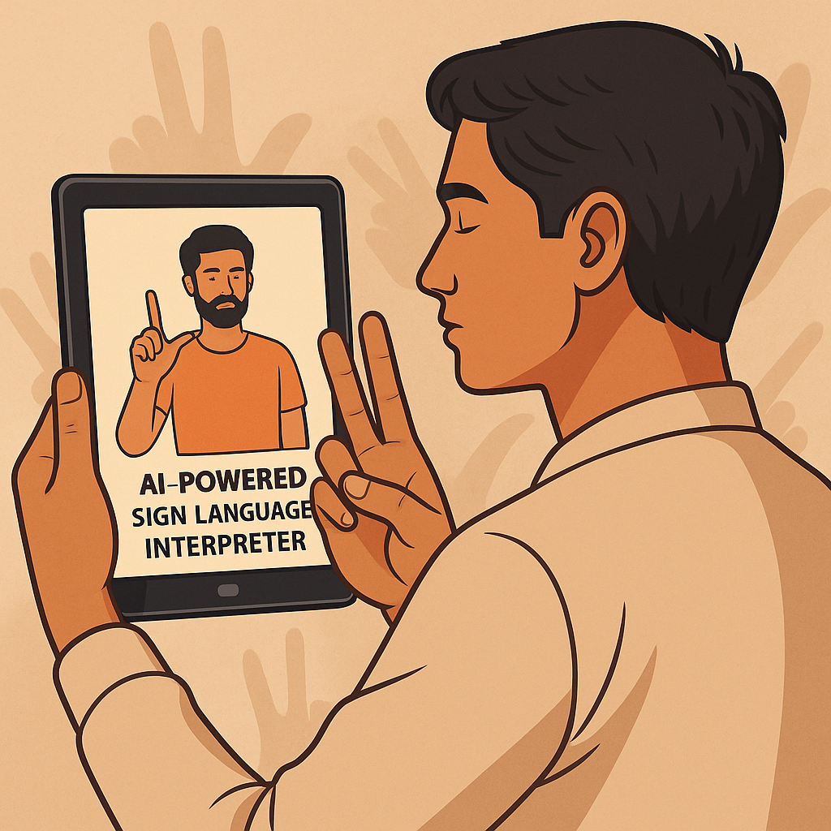


Jansanket: Indian Sign Language Interpreter with Multi- Language Support
Bridging Communication Gaps for the Deaf & Mute Community
Bennett University | Mentor: Ms. Sanchali Das
Team: Devraj Singh Bhadoria, Vaibhavi Rawat, Harshit Gupta

Slide 2
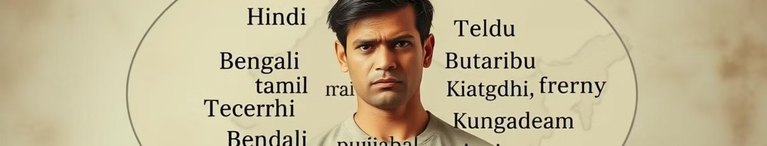
Problem Statement
Communication Barriers
Limited Tools
5M+ deaf/mute individuals in India face challenges
Most tools are online only or support only ASL (American Sign Language)
Language Gap
Offline Need
No regional language support like Hindi, Bengali, Tamil
Critical for rural and low-connectivity areas

Slide 3
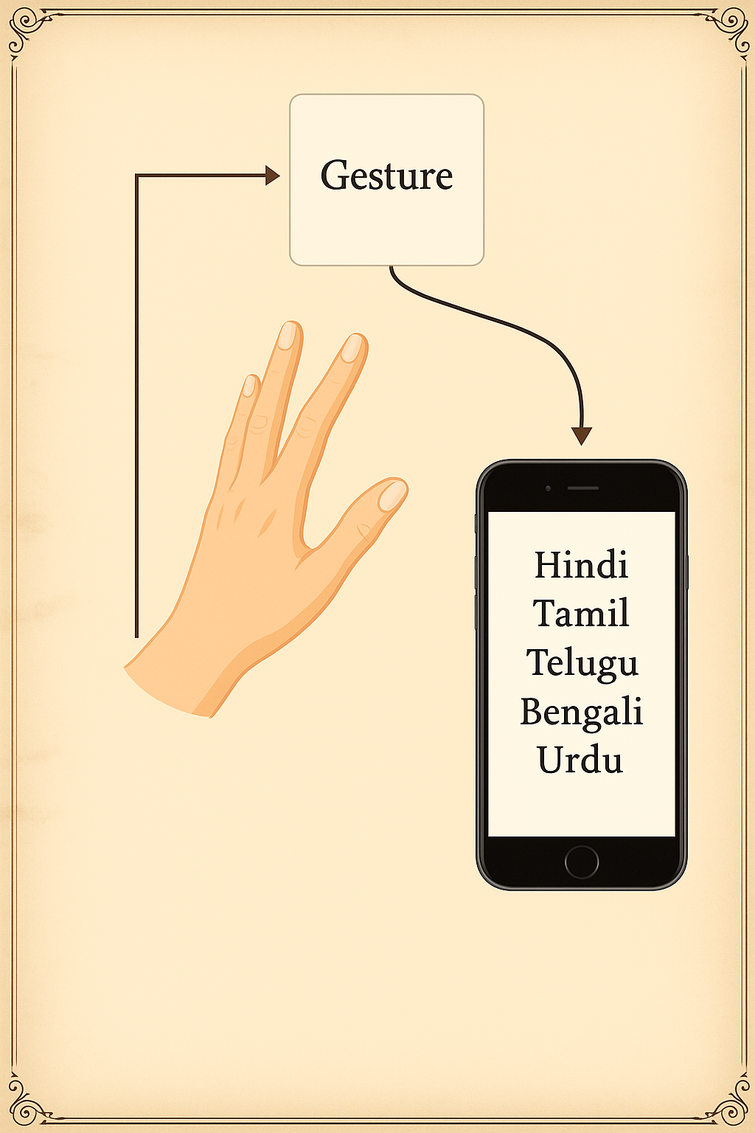
Project Objective
Gesture Recognition
Static ISL hand gestures: alphabet, basic words
Multi-Language Output
Text in 6+ Indian languages
Inclusive Communication
Supports education, healthcare, daily life
Offline-First
Deep learning-based ISL interpreter

Slide 4
Unique Selling Proposition (USP)
Offline Support
Multi-Language Output
Localized for India
Lightweight & Deployable
Works without internet connection
Trained on Indian Sign Language (ISL)
Hindi, English, Bengali,
Tamil , Telugu, Punjabi, Marathi, Kokborok (Tribal)
Runs on mobiles and desktops

Slide 5
System Architecture
Input
Hand gesture image or video
Preprocessing
Resize, normalize, background removal
Deep Learning Model
CNN-based gesture classification
Text Conversion
Mapped to selected language
Output
Displayed text or speech

Slide 6
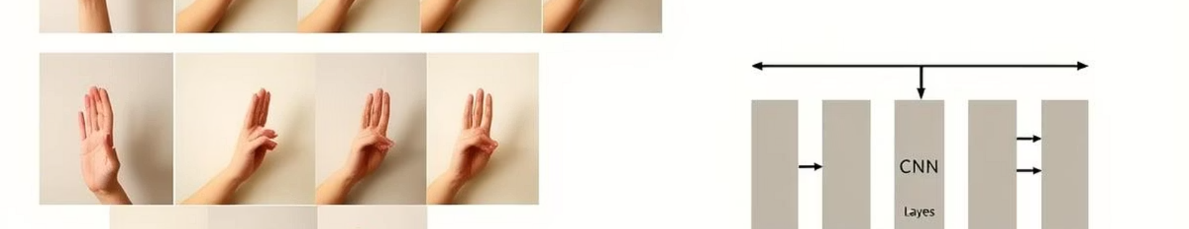




Technical Approach
Dataset
Model
ISL alphabet images from self-created/public datasets
CNN for gesture recognition
Training
Optimization
Augmentation: rotation, flip for robustness
Pruned model for low-latency offline inference

Slide 7
Current Progress & Future Scope
Current
Next Steps
Backend model training on ISL alphabet
Real-time video gesture recognition
Dataset curation: 1000+ images per gesture
Mobile app development (Android)
Expand to dynamic gestures
Community deployment in schools/NGOs
Offline Support

Slide 8
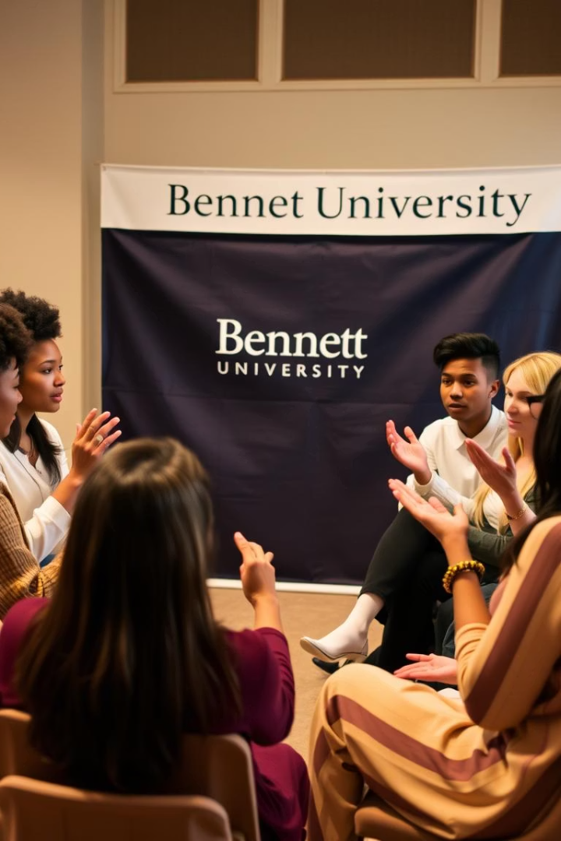

Impact and Conclusion
Empowerment
Supports education, employment, healthcare
Localization
Addresses India’s linguistic diversity
Offline Access
Bridges digital divide
Call to Action
Join us in making communication inclusive!

Slide 9

Thank You
Thank You! We appreciate your interest in Jansanket.
Project Team: Devraj Singh Bhadoria , Vaibhavi Rawat , Harshit Gupta
Contributions: Dataset creation, model development, and community outreach.
Supporters: Schools, NGOs, and local communities partnering for impact.

